Slide 1
Project
PATIENT SURVIVAL PREDICTION
By Project Group 18
Rohith Kanakagiri (469)975-2669
kanakagiri.r@northeastern.edu
Anurag Palanki (617)870-1921
palanki.a@northeastern.edu
IE 7275 Data Mining for Engineering DAE Spring 2022

Slide 2
OBJECTIVE
There are various factors that affect the chances of a patient surviving when admitted to the hospital for treatment. The extent to which hospitals vary in survival outcomes and the degree to which this variation is explained to patients and hospital factors is unknown.
The use of a model to factor in all the predictors to evaluate the survival of a patient would be useful for hospitals to assess the severity of the illness and helps allocate the necessary resources more effectively to patients with lesser chances.
The goal is to select the best classification model to predict the in-hospital mortality rate of patients admitted to the hospital.

Slide 3
Data SOURCE & Description
The dataset was sourced from Kaggle : https://www.kaggle.com/mitishaagarwal/patient
Age:
Age of the patient at admission
BMI:
This refers to the body mass index of patient
Ethnicity:
Used to determine the culture of the patient
Gender:
The sex of the patient
Height:
Height of the patient
APACHE Measurements:
Apache 2j, III diagnosis scores, Apache heart, incubated, map, temperature, GCS verbal, motor, and eyes scores
Vital Signs:
Systolic and diastolic Blood pressure measured invasively and non-invasively
Maximum and minimum heart rate, respiratory rate, spo2 level, potassium, glucose
Other Ailments:
This shows whether the patient has any other ailments like aids, diabetes, cirrhosis, hepatic failure, leukemia, lymphoma, solid tumor carcinoma, and if patient was on immunosuppressants

Slide 4
Data preprocessing
The dataset contains 85 variables and 91712 rows.. Column “Unnamed:83” only consists of null values so it was removed.
Variables like ‘patient_id’, 'encounter_id’, ‘patient_id’, 'hospital_id', 'ice_admit_source',’ icu_id’,'icu_type’ and 'icu_stay_type’ are redundant and not constructive in building the model.
We dropped rows with more than 8 null values in it since imputation of too many variables is not desirable
After doing all the above operation we ended up with 77 columns with 85996 records. Out of the 77 variables, 55 are numerical and 22 are categorical variables

Slide 5
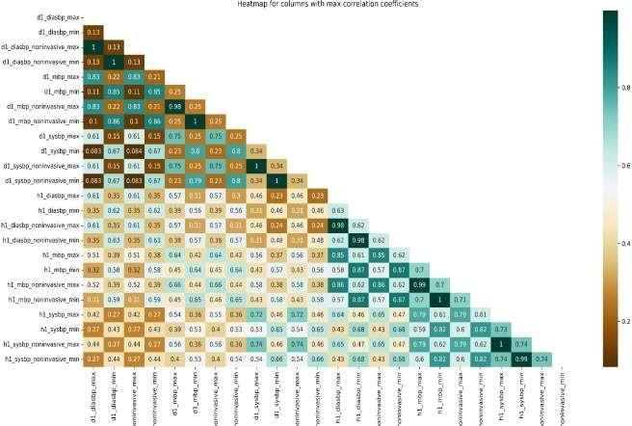
Corr plot to show correlation
Showing the correlation between various numerical values in the data frame. , the blood pressure columns are the columns with the most correlation between them since there are multiple ways to measure a person’s blood pressure but ultimately, they all yield similar results.

Slide 6
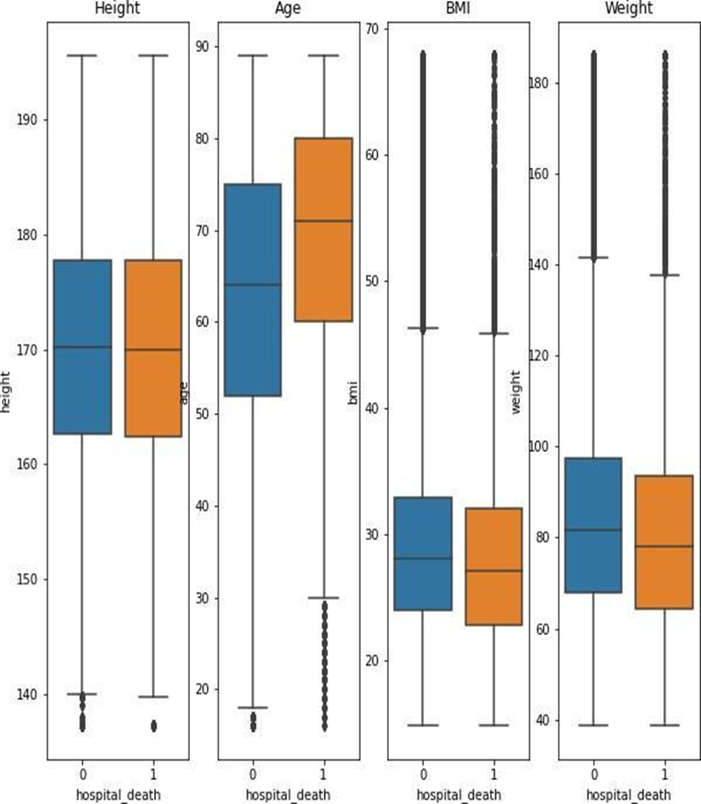
Pie chart depicting number of good bad male female
The height of patients in case of both survivors and non survivors is about same so the effect of the height of a person doesn’t have an impact on the survival outcome. With respect to age of a patient, as expected the older a patient is the more the chances of the patient not surviving when struck with any ailments.
Surprisingly, when it comes to weight and body mass index, the opposite of what is expected is seen, the median weight and bmi of non survivors is lower than the survivors.

Slide 7
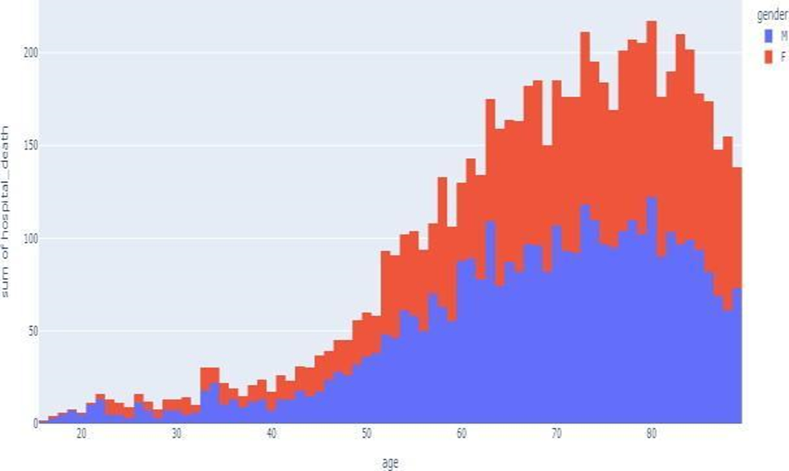
Histogram
The ratio of males to females in the dataset is about 54:46 but the graph of the number of deaths vs the age and gender of the patient shows the number of female patients not surviving is more

Slide 8
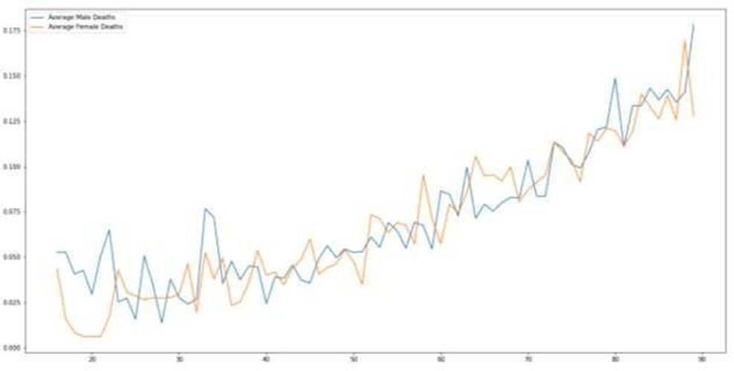
LINE plot
Although the number of males surviving is more overall the average number of non survivors vs age shows an almost equal distribution at almost every age.

Slide 9
DATA Mining tasks
For implementing data mining models, we first need to remove the null values. For this we used KNN Imputer after running KNN Classifier to determine the best k value to use for the imputer.
To implement distance-based models, we removed the columns that are highly correlated with each other linearly. We ended up dropping 23 columns to do this and implement regression models.
We split both the feature and outcome data into testing data and training data in a 1:3 split (25% testing data and 75% training data). The split data has 68784 rows in the training set and 22929 rows in the testing set.
After splitting the data, we encoded the categorical variables (Ethnicity, Gender, Apache_3j_bodysystem, Apache_2_bodysystem) which contained text data while the other variables were already in numerical form.

Slide 10
DATA MINING tasks (CONTD)
After encoding we normalized the training and test data based on the mean and standard deviation of the training data.
Since the data only has about 8.6% of patients who don’t survive, we decided to oversample the minority class in the training set to balance the data using Synthetic Minority Oversampling Technique.
After oversampling the minority class the total number of rows in the data ended up being 117878.

Slide 11
Data mining models
We chose to implement Logistic Regression Classifier, Gaussian Naïve Bayes Classifier, Gradient Boosting Classifier, Neural Network.
We chose these models since they work very well with large datasets and are widely used for classification problems.
The features include all the variables except the hospital death column which is the target variable y.

Slide 12
Logistic regression
It's a form of statistical software that analyzes the association between a dependent variable and one or more independent variables by estimating probabilities using a logistic regression equation.
The base logistic regression model was executed on data which was scaled, oversampled and encoded. Solver ‘lbfgs’, parameters ‘l2’, class weight = ‘balanced’ and max iteration = 1000, were used as the ideal parameters for training the model. The resulting model showed an accuracy of 92% but a specificity of 0.19 and sensitivity of 0.985

Slide 13
Performance evaluation
The sensitivity shows the accuracy of the model in predicting the chance of a patient surviving and depicts a high true positive value but the low specificity shows that the model is not able to predict the likelihood of not surviving. The f1 score is also similarly not high.
Logistic regression assigns each row a probability of belonging to a class and classifies data by applying a default threshold of 0.5. We altered the threshold to check and improve the outcome of the model.
We used the f1 score and the point where the sensitivity and specificity of the model were equal to tune the model resulting in an accuracy of 81.11% and 75.6% respectively.

Slide 14
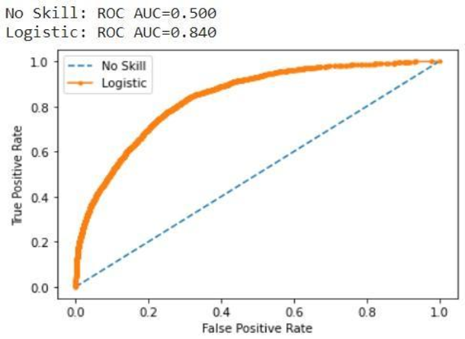
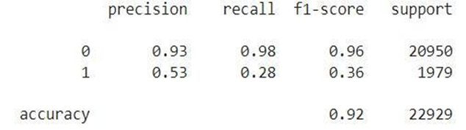
Evaluation metrics
Confusion Matrix | Predicted (Will Survive) | Predicted (won’t survive)
Actual (Survived) | 17324 | 3626
Actual (Didn’t Survive) | 691 | 1288

Slide 15
Naïve bayes classifier
Naïve bayes is a model that calculates the probabilities of an outcome by assuming that the features are independent
It applies the bayes theorem to calculate the probabilities of an input variable belonging to a certain class.
The Gaussian Naive Bayes classifier model was executed, resulting in an accuracy of 85%
No hyperparameter tuning was done since the base Guassian Naïve bayes model worked best for the input data.

Slide 16
Performance evaluation
The obtained accuracy was 80%. Although lower than logistic regression, the specificity for the model drastically increased to 57% while the sensitivity dropped to 88%.
The sensitivity shows the accuracy of the model in predicting the chance of a patient surviving and depicts a high true positive value but the relatively low specificity shows that the model is not able to predict the likelihood of a patient succumbing to their ailments in the hospital.
The Area under the curve for Naïve Bayes Classifier is not higher than that of logistic regression with only a value of 0.824. The f1 score is 0.4 for class -1 which is the case where the patient doesn’t survive.

Slide 17
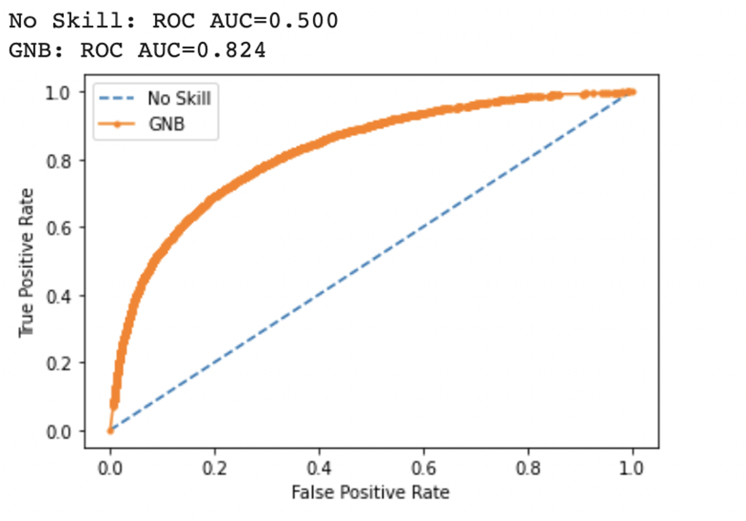
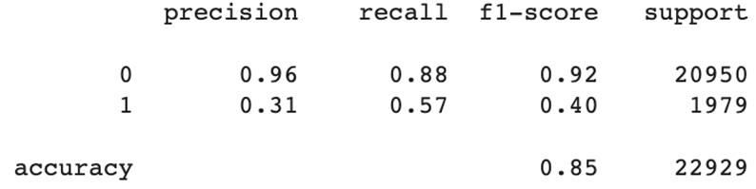
Evaluation metrics
Confusion Matrix | Predicted (Will Survive) | Predicted (won’t survive)
Actual (Survived) | 18434 | 2516
Actual (Didn’t Survive) | 850 | 1129

Slide 18
Gradient boosting
Gradient Boosting algorithm is a machine learning model that is an ensemble of weaker models
The weaker models in gradient boosting are usually decision trees.
The Gradient Boosting classifier model was executed with criterion as squared mean and the minimum number of samples per leaf as 10000 (to avoid overfitting) , resulting in an accuracy of 82 %.
Grid Search CV was used to determine the optimal hyper parameter for the model.

Slide 19
Performance evaluation
For implementing Radom Forest with gradient boosting the best result was obtained by limiting the minimum samples per leaf to 10000 (which is about 10% of the oversampled data that was input into the model).
Using oversampled data, the accuracy obtained was 81%. The specificity for the model is 79% while the sensitivity was found to be 81%. The sensitivity and specificity are nearly equal in the case of naïve bayes model.

Slide 20
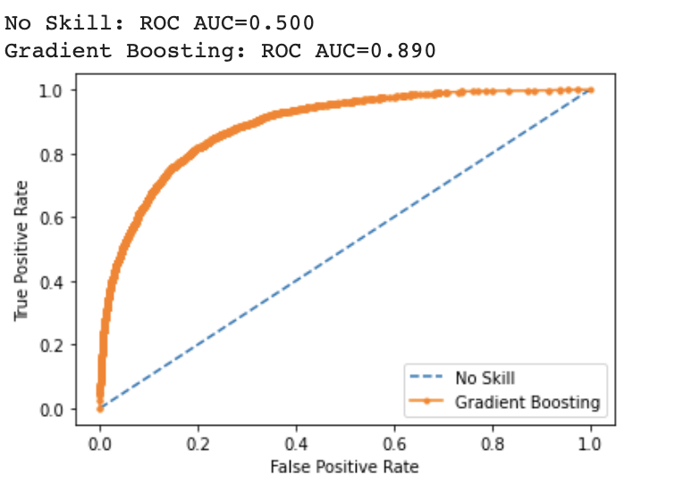
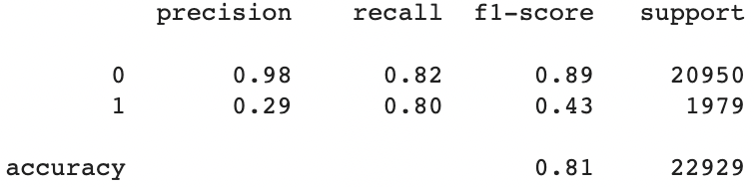
Evaluation metrics
Confusion Matrix | Predicted (Will Survive) | Predicted (won’t survive)
Actual (Survived) | 17103 | 3847
Actual (Didn’t Survive) | 402 | 1577

Slide 21
Neural networks
It’s a popular machine learning model that mimics the working of a human brain.
Grid Search CV was again used to determine the optimal hyper parameters for the model - 'activation': 'relu', 'alpha': 0.0001, 'hidden_layer_sizes': (2), 'learning_rate': 'adaptive', and 'solver': 'adam'.
The Neural networks model was executed, resulting in an accuracy of 82%.
The specificity for the model is 76% while the sensitivity was found to be 82.3%.

Slide 22
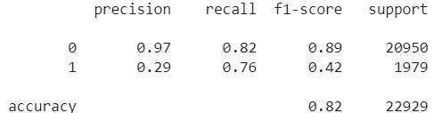
Performance evaluation
The sensitivity and specificity are again nearly equal like in the case of gradient boosting model. The f1 score is 0.42 for class -1 which is the case where the patient does not survive and the f1 score for the surviving class is 0.89, similar to gradient boosted model.
Confusion Matrix | Predicted (Will Survive) | Predicted (won’t survive)
Actual (Survived) | 17234 | 3716
Actual (Didn’t Survive) | 476 | 1503

Slide 23
PROJECT RESULTS
The results show that the Gradient Boosting model worked best for the given data. The reason we selected this as the best model for the data is because the model has a higher accuracy in predicting the patients who do not survive without classifying all or a most of the data into the majority class thus improving the accuracy but compromising on the predictive power of the model.
Model/Metrics | Accuracy | Sensitivity | Specificity | F1(0) | F1(1)
Logistic regression | 81 | 82 | 75 | 96 | 37
Naïve Bayes | 85 | 88 | 57 | 92 | 40
Gradient Boosting | 81 | 81 | 79 | 89 | 43
Neural Network | 82 | 82 | 76 | 89 | 42

Slide 24
Impact of project outcomes
The goal of the project was to implement a model which would help predict the outcome of a patient surviving after having been to the ICU. Numerous parameters (80) were taken into consideration to build a model to help achieve this.
Being able to predict the mortality of a patient is very useful in assessing the severity of the illness and helps allocate resources and time to lessen the chances of succumbing to the ailments.
It was observed that the gradient boosting model based on regression trees worked best in doing this task due its relatively high f1 score and accuracy in both predicting the survivors and non survivors without any bias towards one.

